Slide 1

Predicting the Performance of Students’ in CS Track Using Machine Learning Techniques
International Islamic University Chittagong
Department of Computer Science & Engineering
Presented by,
Md. Aref Billah C-141044
Sheikh Arif Ahmed C-141076
Dept. of CSE, IIUC.
Supervised by,
Shahidul Islam Khan
Associate Professor,
Dept. of CSE, IIUC

Slide 2
Objectives
To predict students’ final result and programming skill
To find out the most important features that indicates their success in CS
To classify the students’ profile into it’s belonging class

Slide 3
Motivation
Less effective and unskilled CS graduates are failing to make an impact in the IT sector
A classification technique is necessary
Many students taking CS without assessing their potential
Students hesitate to switch their M.S program

Slide 4
Challenges
Data collection
Important feature extraction
Classify in terms of success & failure
Data Preprocessing

Slide 5
Application
Forecasting students final result and programming skill
Classifying students’ profile before they choose CS

Slide 6
Related Works
In [1], conducted a study on students participation in on-line discussion forum and predicted students’ final performance in Spain.
They collected forum interaction data such as number of messages post/read, ask and reply relationship between students.
Work on predicting students’ final result by analyzing students performance was done in [2].
Data was collected form the central database of Military Institute of Science Technology(MIST) and used J48 Data Mining algorithm for final result prediction
Afterwards compared them in between classification and classification via clustering approach.
Generated a Classification tree.

Slide 7
Related Works (Continue)
A recommendation system was build for prediction study track for students’ in India [3]
Past history of the students who have succeed in their academic area were collected
In [4], proposed a classification model for predicting suitable track for the students of Jordan
Collected data from the students of class 9-10 and 11-12
They used FCM for clustering student’s profiles and used C4.5 algorithm for classifying the students into the course and the college which they matches to them
Then determined suitable track for students using Decision Tree
The accuracy of their model was 87.9%

Slide 8
Contribution
Developing a classification model for students
Predicting students programming skill and CGPA
Building Students profile for CS perspective
Finding dependencies and reason behind success in CS

Slide 9
Proposed Method
Proposed method follows machine learning techniques
Training Data
Feature Vectors
Estimator Algorithm
Build Phase
Labels
New Data
Feature Vectors
Predictive Model
Predictions
Operational Phase
Figure : Overview of machine learning techniques

Slide 10
Proposed Method
Data Collection
Preprocessing
Data Mining
Result Analysis
No
Performance Evaluation
Found Best and efficient algorithm?
Yes
Build Model
Figure : Build Phase of Proposed Method

Slide 11
Proposed Method
Preprocessing of Data
Cleaning
Transformation
Integration
Standardization
Feature Selection
Figure : Stages of Preprocessing

Slide 12
Proposed Method
Data Mining Algorithms
Regression
Clustering
Classification
Multiple Linear Regression
K-Means
KNN
Naïve Bayes
C 4.5
Random Forest
SVR
SVM
Figure : Proposed Data mining techniques

Slide 13
Proposed Method
Result Analysis and Performance Measurement
Error Evaluation of Regression
Error Evaluation of Classification
RMSE
Accuracy
F-Measure
MAE
Precision
Recall etc.
Figure : Error Evaluation & Performance measurement

Slide 14
Proposed Method
Students Input
Predict CGPA & Programming Skill
Building Students Profile
Clustering
Classification
Decision
Okay
Not Okay
Okay Profile for CSE
Not Okay Profile for CSE
Figure : Operational Phase

Slide 15
Proposed Method
Academic Result
Personal Interest
Experience with ICT
Student’s Profile
Problem Solving Skills
Online Course Experiences
Other Experiences
Figure : Building Student Profile

Slide 16
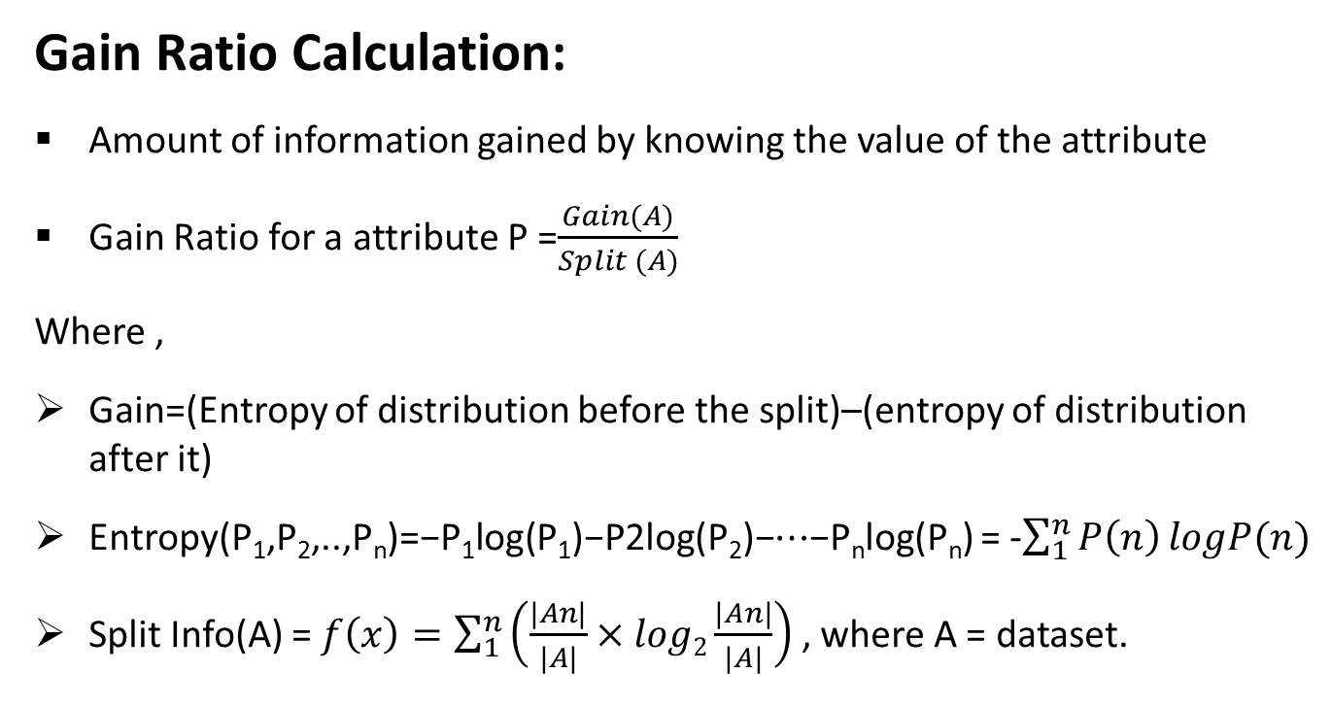
Selecting Features
Gain Ratio Calculation:
Amount of information gained by knowing the value of the attribute
Gain Ratio for a attribute P =$\frac{Gain(A)}{Split (A)}$
Where ,
Gain=(Entropy of distribution before the split)–(entropy of distribution after it)
Entropy(P₁,P₂,..,P_{n})=−P₁log(P₁)−P2log(P₂)−⋯−P_{n}log(P_{n}) = -$\sum_{1}^{n}{P\left(n\right)}logP(n)$
Split Info(A) = $f\left(x\right)=\sum_{1}^{n}{\left(\frac{|An|}{|A|}×log2\frac{|An|}{|A|}\right)}$ , where A = dataset.

Slide 17
Feature Extraction
TABLE : Selected Features By Gain ratio
Selected Features | Gain Ratio
ProRatings | 0.5486
MSOlym | 0.5344
SSR | 0.4933
Cpro | 0.4839
NOC | 0.4833
CCGPA | 0.4701
PaRatings | 0.4125
HMATH | 0.2911
IBReason | 0.2528
BMath | 0.248
ICTResult | 0.2396

Slide 18
Feature Extraction(continue..)
Figure : Graphical representation Selected Features

Slide 19
Experimental Results
TABLE :Error Evaluation for different regression algorithms while predicting students CGPA
Evaluation Criteria | Multiple Linear Regression | C4.5 | SVR (Linear kernel) | SVR (Poly kernel)
Mean Absolute Error | 0.1180 | 0.1555 | 0.1123 | 0.1409
Root Mean Square Error(RMSE) | 0.1712 | 0.2517 | 0.1604 | 0.2117

Slide 20
Experimental Results
TABLE: Cross validation of different algorithm (CGPA)
Evaluation Criteria | Multiple Linear Regression | C4.5 | SVR (Linear kernel) | SVR (Poly kernel)
Score | 0.8560 | 0.8367 | 0.8615 | 0.8488
Cross-predicted Accuracy {k(10)-Fold} | 0.7734 | 0.6019 | 0.7806 | 0.6009

Slide 21
Experimental Results
TABLE: Error Evaluation for different regression algorithms while predicting students Programming skill
Evaluation Criteria | Multiple Linear Regression | C4.5 | SVR (Linear kernel) | SVR (Poly kernel)
Mean Absolute Error | 0.5226 | 0.4242 | 0.5036 | 0.4596
Root Mean Square Error(RMSE) | 0.6899 | 0.7881 | 0.6880 | 0.6584

Slide 22
Experimental Results
TABLE :Cross validation of various algorithm for the dataset while predicting students Programming Skill
Evaluation Criteria | Multiple Linear Regression | C4.5 | SVR (Linear kernel) | SVR (Poly kernel)
Score | 0.71856 | 0.83956 | 0.6950 | 8835
Cross-predicted Accuracy {k(10)-Fold} | 0.5476 | 0.5121 | 0.5293 | 0.4969

Slide 23
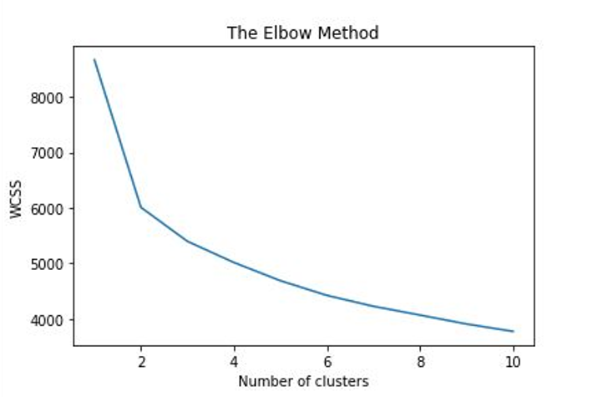
Clustering
While clustering with K-Means using WCSS with Elbow method, elbow method suggests clearly two cluster
Fig. 4: Cluster suggestion from Elbow Method

Slide 24
Clustering
TABLE: shows Statistical difference between two clusters by mean of important attributes
 | Cluster |  | Statistic Derivation
Attribute | 1 | 2
ProRatings | 4.1415 | 3.335 | Mean
 | 0.7325 | 0.8036 | Std. dev
MSOlym | 3.8821 | 1.7747 | Mean
 | 1.086 | 0.7478 | Std. dev
SSR | 4.3774 | 2.7637 | Mean
 | 0.598 | 0.9342 | Std. dev
Cpro | 4.1415 | 2.3901 | Mean
 | 0.8002 | 0.9356 | Std. dev
NOC | 4.3255 | 2.5385 | Mean
 | 0.6887 | 1.2475 | Std. dev
CCGPA | 3.6442 | 3.0897 | Mean
 | 0.2572 | 0.3101 | Std. dev

Slide 25
Clustering
Domain knowledge used to label newly created clusters as “Ok” and “Not OK”
TABLE : shows the labeling of two newly created clusters and their percentages.
Cluster | Label | Student | Percentage (By K-Means)
1 | OK | 212 | 54%
2 | Not OK | 182 | 46%

Slide 26
Classification Process
Various statistical observation run through collected data
Observed clustered data for pattern
New attribute made with the clustering and labeling information
Closely observed Ok and Not OK class
Classification model was made through various algorithm

Slide 27
Experimental Results for Classification
TABLE : shows the confusion matrix of different classifier
Classifier | OK | Not OK
KNN | 206 | 6 | OK
 | 4 | 178 | Not OK
Naive Bayes | 205 | 7 | OK
 | 2 | 180 | Not OK
Random forest tree | 208 | 4 | OK
 | 2 | 180 | Not OK
SVM (linear) | 211 | 1 | OK
 | 4 | 178 | Not OK
SVM (RBF) | 210 | 2 | OK
 | 3 | 179 | Not OK

Slide 28
Experimental Results for Classification
Fig. 4: Correctly and incorrectly classified

Slide 29
Experimental Results for Classification
TABLE : shows accuracy of different classifier algorithm.
Algorithm | Accuracy
KNN | 97.46
Naïve Bayes | 97.71
Random Forest | 98.41
SVM( Linear) | 98.73
SVM( RBF) | 98.73

Slide 30
Experimental Results for Classification
Fig. : Accuracy rate of various classifier

Slide 31
Experimental Results for Classification
linear and RBF have same accuracy
Linear kernel gives less true positive which is efficient
TABLE : shows comparison of SVM linear and RBF kernels confusion matrix
Kernel of SVM | OK | Not OK
Linear | 211 | 1 | OK
 | 4 | 178 | Not OK
RBF | 210 | 2 | OK
 | 3 | 179 | Not OK

Slide 32
Experimental Results for Classification
TABLE : shows true positive and false positive rate of different classifier by two class
Classifier | TP | FP | Class
KNN | 0.972 | 0.022 | OK
 | 0.978 | 0.028 | Not OK
Naive Bayes | 0.967 | 0.011 | OK
 | 0.989 | 0.033 | Not OK
Random forest tree | 0.981 | 0.011 | OK
 | 0.989 | 0.019 | Not OK
SVM (linear) | 0.995 | 0.022 | OK
 | 0.978 | 0.005 | Not OK

Slide 33
Experimental Results for Classification
TABLE : shows true positive and false positive rate of different classifier by two class
Classifier | Precision | Recall | F-Measure
KNN | 0.9717 | 0.9810 | 0.9763
Naive Bayes | 0.9670 | 0.9903 | 0.9785
Random forest tree | 0.9811 | 0.9905 | 0.9858
SVM (linear) | 0.9953 | 0.9814 | 0.9883

Slide 34
Experimental result for Classification
The accuracy of this SVM method with linear kernel is 98.73%
SVM linear and RBF kernel of SVM have the accuracy rate
Other measurement like precision, recall, f-measure for SMV was best
SVM with linear kernel is the best option for our model

Slide 35
Conclusion
Predicted CGPA and programming skill
Found two clusters from the dataset
Labeled clusters using domain knowledge
Build model using SVM with linear kernel which has best accuracy
Extracted most important features

Slide 36
References
[1] | Cristobal Romero, Manuel-Ignacio Lopez, J. Luna and S. Ventura, “Predicting students’ final performance from participation in on-line discussion forums,”, Elsevier, 2013.
[2] | Yeasmin, Suraiya, Rubayat Jinnah, and Atoshi Islam. "Analysis of Student Performance using Data Mining." PhD diss., Department of Computer Science and Engineering, Military Institute of Science and Technology, 2014.
[3] | S. Venkata, Krishna Kumar and S.Padmapriya, ” An Efficient recommender system for predicting Study Track to students using data mining techniques,” International Journal of Advanced Research in Computer and Communication Engineering, 2014.
[4] | Qasem A. Al-Radaideh, Emad M. Al-Shawakfa Mustafa and I. Al-Najjar, “Mining students data using Decision Trees,” The 2006 International Arab Conference on Information Technology (ACIT’2006), Nov. 2006.
[5] | Daud, Ali, Naif Radi Aljohani, Rabeeh Ayaz Abbasi, Miltiadis D. Lytras, Farhat Abbas, and Jalal S. Alowibdi. "Predicting student performance using advanced learning analytics." In Proceedings of the 26th International Conference on World Wide Web Companion, pp. 415-421. International World Wide Web Conferences Steering Committee, 2017.
[6] | M. Ramaswami and R. Bhaskaran, “A CHAID based performance prediction model in educational data mining,” International Journal of Computer Science, vol. 7, no. 1, pp. 10-18, 2010.
[7] | Tair, Mohammed M. Abu, and Alaa M. El-Halees. "Mining educational data to improve students' performance: a case study." International Journal of Information 2, no. 2 (2012): 140-146.
[8] | Bhardwaj, Brijesh Kumar, and Saurabh Pal. "Data Mining: A prediction for performance improvement using classification." arXiv preprint arXiv:1201.3418 (2012).
[9] | Baradwaj, Brijesh Kumar, and Saurabh Pal. "Mining educational data to analyze students' performance." arXiv preprint arXiv:1201.3417 (2012).
[10] | Daily Industry News, “Bangladesh becomes 4th largest remittance source for India”, 2018

Slide 37
References
[11] | Cesar Vialardi, Javier Bravo, Leila Shafti, and Alvaro Ortigosa, “Recommendation in Higher Education Using Data Mining Techniques,” Educational Data Mining 2009.
[12] | E. Osmanbegovic and M. Suljic, “Data mining approach for predicting students’ performance,” Economic Review, vol. 10, no. 1, pp. 3-12, 2012.
[13] | Waraporn Jirapanthong, “Classification Model for selecting undergraduate Programs,” 2009 Eighth International Symposium on Natural Language Processing.
[14] | Alharbi, Zahyah, James Cornford, Liam Dolder, and Beatriz De La Iglesia. "Using data mining techniques to predict students at risk of poor performance." (2016).
[15] | Goga, Maria, Shade Kuyoro, and Nicolae Goga. "A recommender for improving the student academic performance." Procedia-Social and Behavioral Sciences 180 (2015): 1481-1488.
[16] | Alfiani, Ardita Permata, and Febriana Ayu Wulandari. "Mapping student's performance based on data mining approach (a case study)." Agriculture and Agricultural Science Procedia 3 (2015): 173-177.
[17] | Al-Radaideh, Ahmad Al Ananbeh, and Emad M. Al-Shawakfa, “A classification model for predicting the suitable study track for school students,” International Journal for Research and Reviews in Applied Science, 2011.
[18] | Mativo, John M., and Shaobo Huang. "Prediction of students' academic performance: Adapt a methodology of predictive modeling for a small sample size." In Frontiers in Education Conference (FIE), 2014 IEEE, pp. 1-3. IEEE, 2014.
[19] | Arsad, Pauziah Mohd, and Norlida Buniyamin. "A neural network students' performance prediction model (NNSPPM)." In Smart Instrumentation, Measurement and Applications (ICSIMA), 2013 IEEE International Conference on, pp. 1-5. IEEE, 2013.

Slide 38
References
[19] | Arsad, Pauziah Mohd, and Norlida Buniyamin. "A neural network students' performance prediction model (NNSPPM)." In Smart Instrumentation, Measurement and Applications (ICSIMA), 2013 IEEE International Conference on, pp. 1-5. IEEE, 2013.
[20] | Huang, Shaobo, and Ning Fang. "Work in progress: Early prediction of students' academic performance in an introductory engineering course through different mathematical modeling techniques." In Frontiers in Education Conference (FIE), 2012, pp. 1-2. IEEE, 2012.
[21] | Patil, Priyanka Anandrao, and R. V. Mane. "Prediction of Students Performance Using Frequent Pattern Tree." In Computational Intelligence and Communication Networks (CICN), 2014 International Conference on, pp. 1078-1082. IEEE, 2014.
[22] | Guleria, Pratiyush, Niveditta Thakur, and Manu Sood. "Predicting student performance using decision tree classifiers and information gain." In Parallel, Distributed and Grid Computing (PDGC), 2014 International Conference on, pp. 126-129. IEEE, 2014.
[23] | Bunkar, Kamal, Umesh Kumar Singh, Bhupendra Pandya, and Rajesh Bunkar. "Data mining: Prediction for performance improvement of graduate students using classification." In Wireless and Optical Communications Networks (WOCN), 2012 Ninth International Conference on, pp. 1-5. IEEE, 2012.
[24] | Hijazi, S. T., and Naqvi, R.S.M.M., “Factors Affecting Student’s Performance: A Case of Private Colleges”, Bangladesh e-Journal of Sociology, Vol. 3, No. 1, 2006.
[25] | Pandey, Umesh Kumar, and Saurabh Pal. "Data Mining: A prediction of performer or underperformer using classification." arXiv preprint arXiv:1104.4163 (2011).

Slide 39
Thank you

